Slide 1

Handwriting Recognition System
Arsh Srivastava (E23CSEU0316)
Krrish Chhabra (E23CSEU0320)
Navya Kapoor (E23CSEU0251)

Slide 2

Introduction
Optical Character Recognition (OCR) is a powerful tool that converts handwritten or printed text into machine-readable text. This project aims to develop an system capable of accurately recognizing handwritten characters, leveraging machine learning techniques to overcome challenges such as varied handwriting styles and noisy image data. The significance of this technology lies in its potential to automate tasks such as data entry and document digitization.

Slide 3
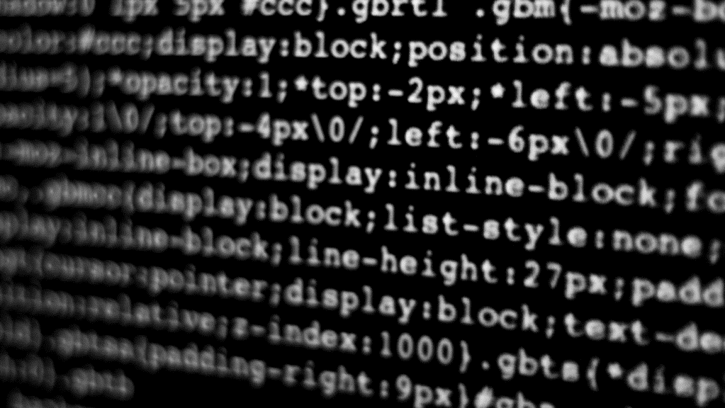
Understanding the Dataset
The dataset used for this project is sourced from Kaggle, known for its comprehensive and high-quality data collections. It contains thousands of labeled images of handwritten characters, providing a diverse range of handwriting samples. Each image in the dataset is paired with a label that represents the corresponding character, making it ideal for supervised learning.
The dataset's structure includes grayscale images, each resized to consistent dimensions for uniform input during model training. The images were analyzed to identify potential challenges, such as class imbalances and noise, which informed our preprocessing strategy. The dataset’s diversity in handwriting styles allows the model to generalize well, making it robust for real-world applications.

Slide 4

Data Preprocessing Techniques
Grayscale Conversion
Handwritten images are typically converted to grayscale (from RGB or color images) to reduce computational complexity while retaining essential information. Grayscale conversion simplifies the data by reducing the dimensions from 3 channels (RGB) to 1 channel (grayscale).
Edge Detection
Edge detection helps highlight the boundaries of characters and strokes, which is essential for the OCR model to discern where one character ends and another begins.
Text Segmentation
Text segmentation is the process of separating text into individual words or characters. In the case of handwritten text, segmentation helps break the image down into manageable pieces for the OCR model.

Slide 5
Exploratory Data Analysis (EDA) is a critical step in any machine learning project, as it helps to understand the underlying patterns, anomalies, and relationships within the dataset. In the context of handwriting recognition OCR (Optical Character Recognition), EDA plays a vital role in analyzing the characteristics of handwritten text data, which can vary significantly across individuals and writing styles.
Exploratory Data Analysis (EDA)

Slide 6
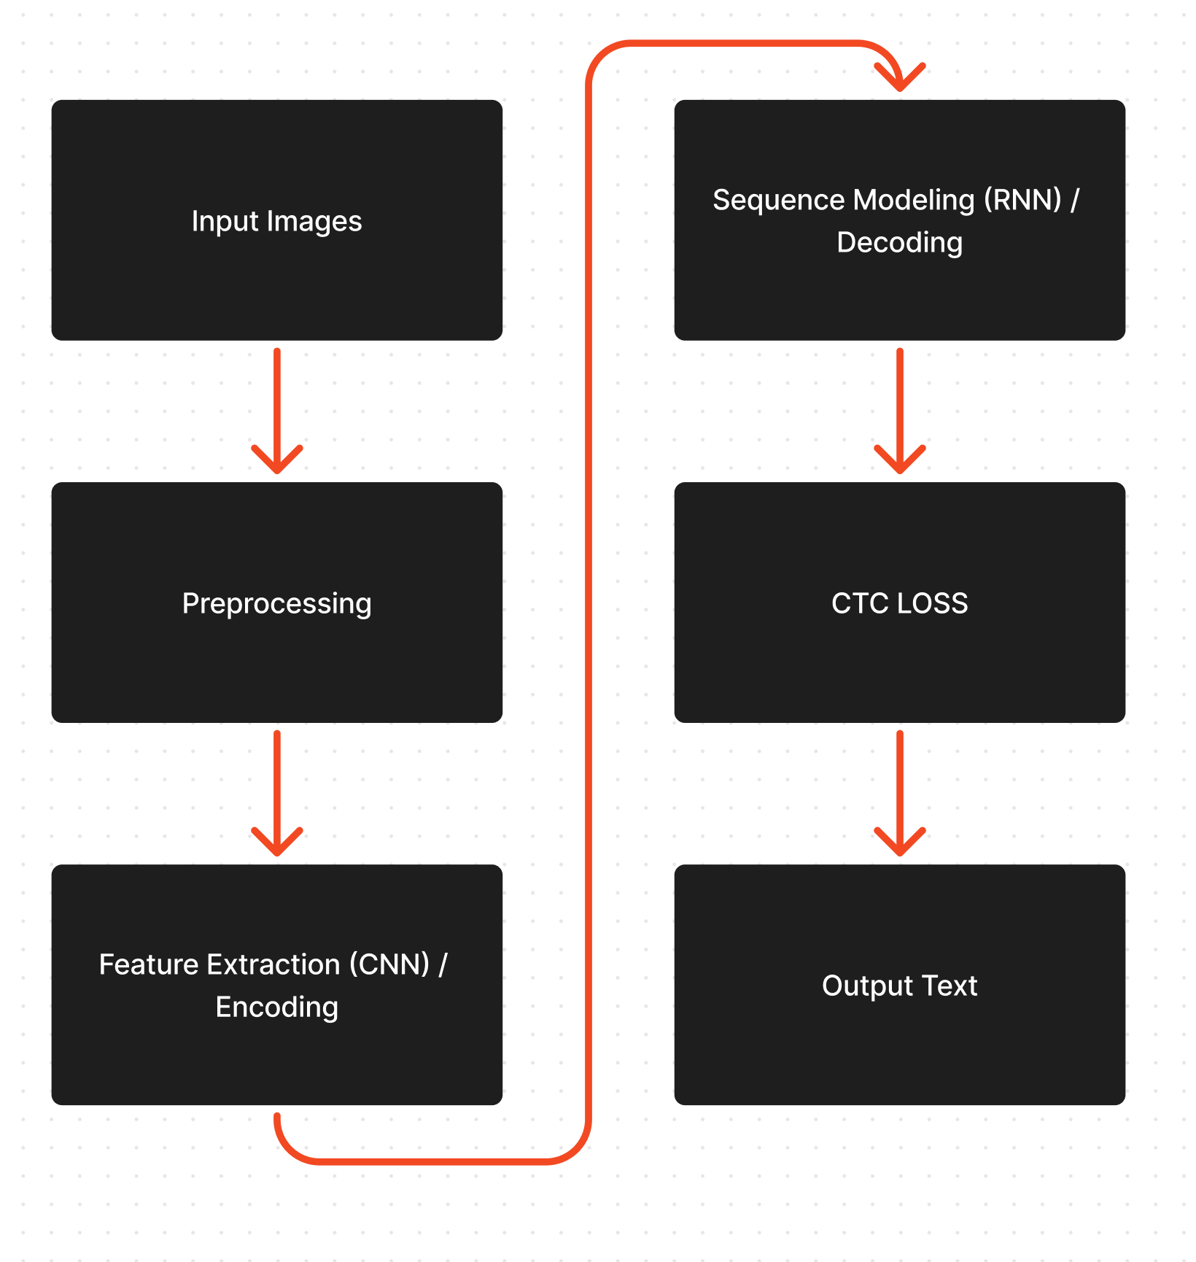
Model Architecture

Slide 7

Training and Validation
The training set provides labeled data for the model to learn from, enabling it to adjust its parameters for accurate predictions.The training dataset is used to teach the model by feeding labeled data, allowing it to learn patterns. The validation dataset evaluates the model's performance during training, providing feedback to tune hyperparameters and prevent overfitting, ensuring better generalization to unseen data.
The validation set tests the model’s ability to generalize, guiding hyperparameter tuning and identifying potential overfitting or underfitting issues.

Slide 8
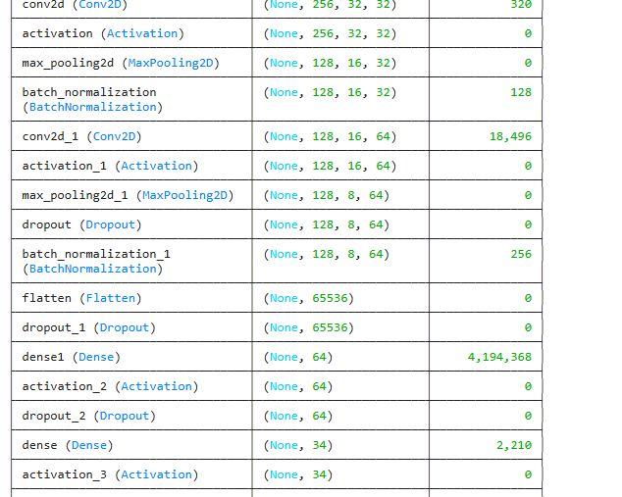
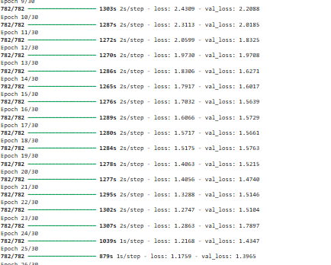
Results and Evaluation

Slide 9
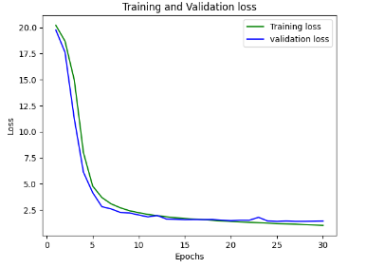
Conclusion and Future Directions
Future Predictions: Handwriting recognition OCR will continue to evolve with advancements in deep learning, enabling better handling of diverse handwriting styles, languages, and noisy environments. Integration with AI-driven systems and real-time recognition will further enhance accuracy and efficiency in various applications.
Conclusion: The handwriting recognition OCR model, by leveraging advanced neural networks and preprocessing techniques, provides valuable tools for automating text recognition, offering significant improvements in accuracy, efficiency, and real-world applications, especially in digitizing handwritten documents.
Thank You

